Slide 1
TRAVEL RECCOMENDATION SYSTEM
Submitted in the partial fulfillment for the award of the degree of
BACHELOR OF ENGINEERING
IN
Artificial Intelligence And Machine Learning
Submitted by:
Harshit Kumar-22BAI70085
Akansha Rohilla – 22BAI70092
Naveen Saini -22BAI70111
Arun Sharma-22BAI70116
Under the Supervision of:
Ms. Priyanka Nanda (E16695)
Department of AIT-CSE
DISCOVER . LEARN . EMPOWER

Slide 2
Outline
Introduction to Project
Problem Formulation
Objectives of the work
Methodology used
Results and Outputs
Conclusion
Future Scope

Slide 3
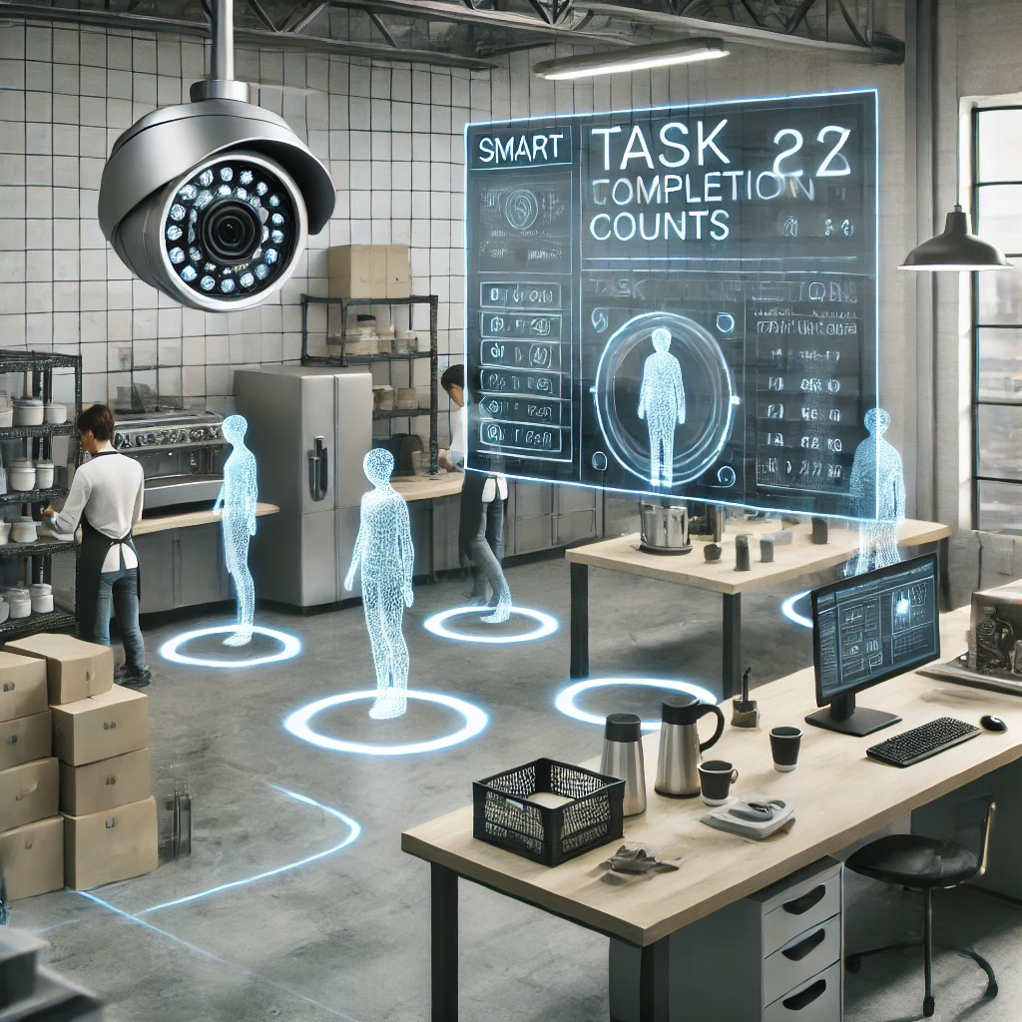
Introduction to Project
The Travel Recommendation System is designed to provide personalized travel suggestions based on user preferences and historical data
It utilizes machine learning (ML), deep learning (DL), and natural language processing (NLP) to analyze user inputs and recommend destinations, accommodations, and activities.
The system aims to reduce decision fatigue and enhance the travel experience through intelligent recommendations.

Slide 4
Problem Formulation
Information Overload: Too many options create confusion.
Time Constraints: Researching travel plans is time-consuming.
Lack of Personalization: Generic suggestions don’t cater to user preference.
Need for Automation: A smart system can simplify travel decisions.
Unstructured Feedback: Manual analysis of reviews and ratings is impractical.

Slide 5
Objectives of the Work
Develop a user-friendly system for travel recommendations
Utilize ML and DL models to personalize suggestions.
Implement NLP for review analysis and sentiment extraction.
Provide Interactive Visualization for better user experience
Ensure scalability and efficiency for real-world usability.

Slide 6
Methodology used
.
Data Collection: Gather travel-related datasets (destinations, user preferences, reviews).
Data Preprocessing: Clean , normalize and structure the data
Feature Engineering: Extract relevant features for ML models.
ML/DL Implementation:
Collaborative Filtering & Content-Based Filtering for recommendation.
NLP Models for review sentiment analysis.
System Deployment: Integrate the models with a web-based interface.

Slide 7
Results and Outputs
Improved Personalization: Users receive tailored travel suggestions.
Sentiment Analysis Accuracy: NLP successfully extracts insights from reviews.
Interactive UI: The front-end provides easy access to recommendations.

Slide 8
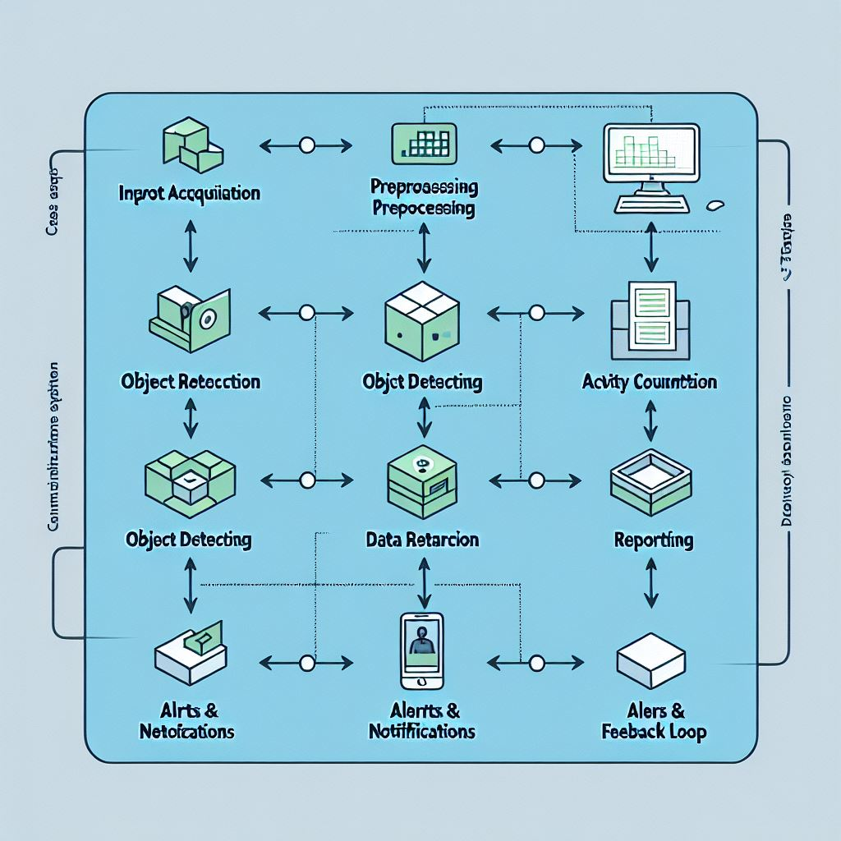
Working Flow

Slide 9
Conclusion
The Travel Recommendation System enhances travel planning by leveraging AI technologies.
ML/DL models improve recommendation accuracy and user engagement.
NLP helps in analyzing reviews and extracting meaningful insights.
The project successfully demonstrates an AI-powered approach to smart travel planning.

Slide 10
Future Scope
Real-time Data Integration: Fetch live reviews and ratings from travel platforms.
Voice-Based Recommendations: Use speech recognition for user inputs.
Augmented Reality (AR): Virtual previews of travel destinations.
Multi-Modal Learning: Combine text, images, and videos for recommendations.
Blockchain Integration: Secure and transparent travel booking system.

